Slide 1
Intro to Software Defined Radios
and GNU Radio

Slide 2

08/25/2025 SMARC Technical Presentation
Primary Presenter:
Paul Maine KI5MIV aka “The SDR Guy”
Assisted by Gary Schafer, Don Mills and Geoffrey Mark

Slide 3
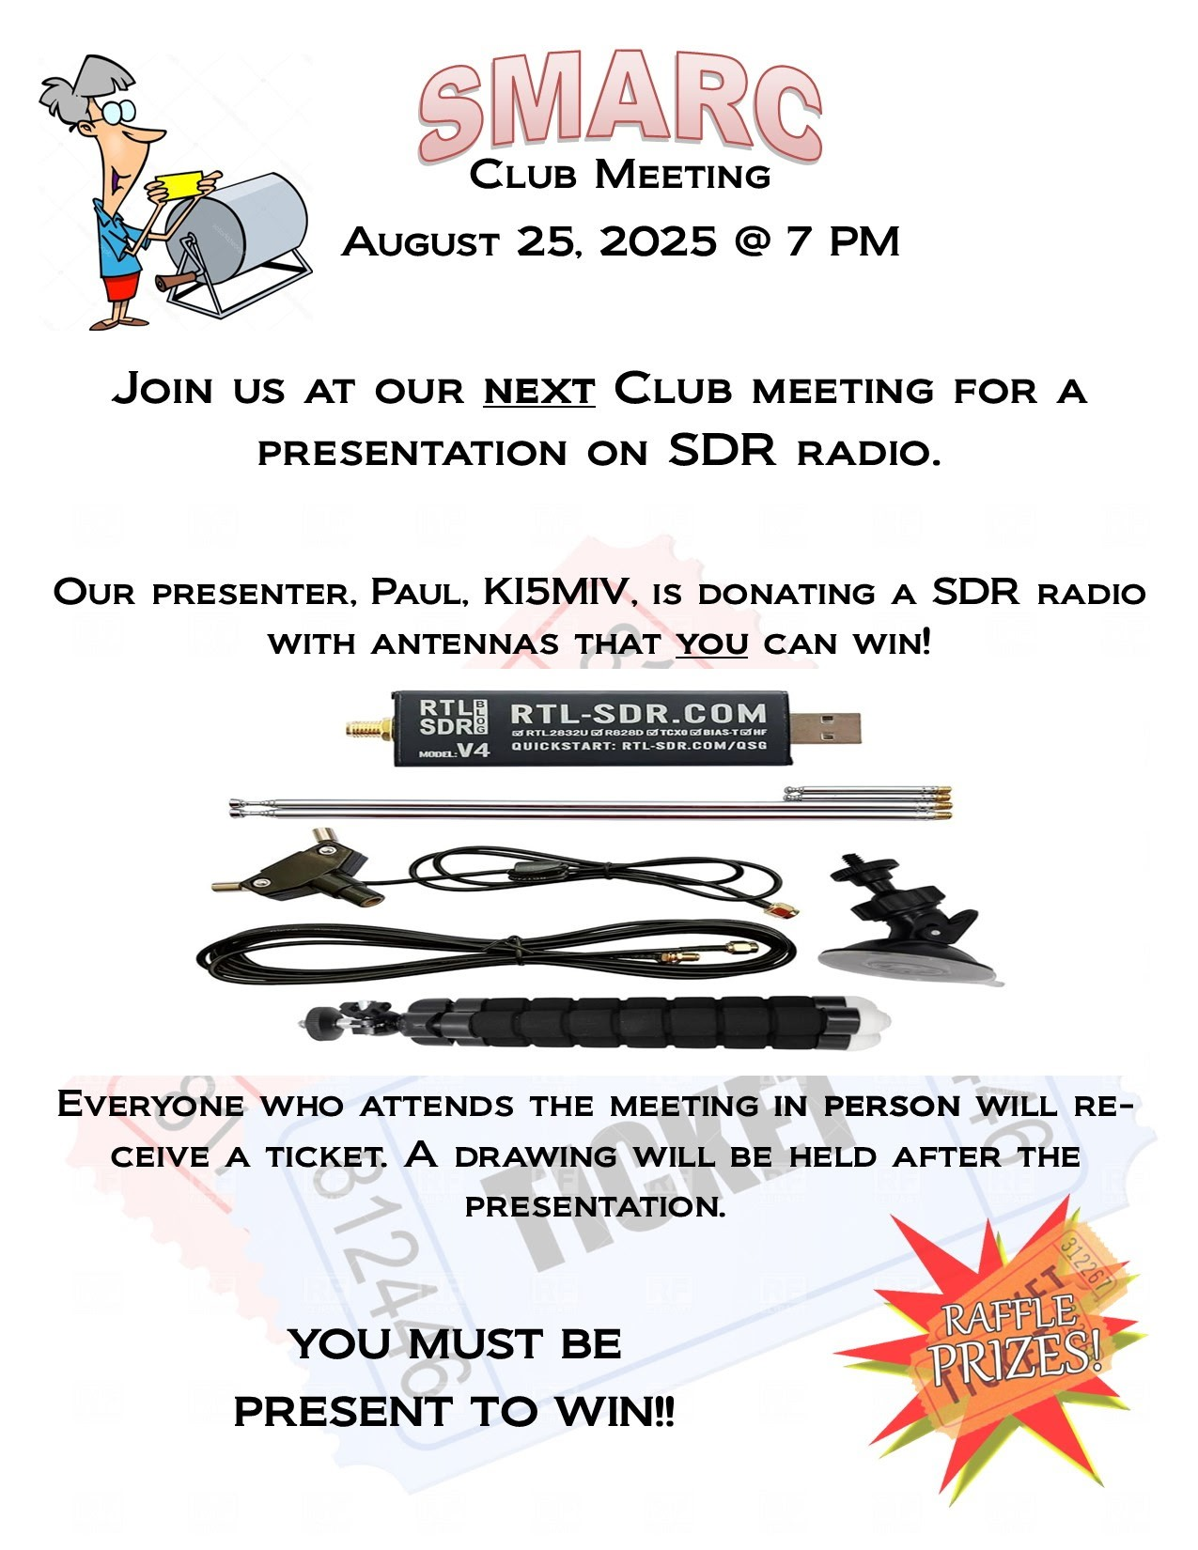
Don’t Forget to Get Your Ticket!

Slide 4
What is an SDR?
A Software-Defined Radio (SDR) is a radio communication system where traditional hardware components like mixers, filters, amplifiers, modulators/demodulators, and detectors—are replaced or implemented by software running on a computer or embedded system.

Slide 5
Simplified Version of How an SDR Works
In a conventional radio, each function (tuning, filtering, modulation, etc.) is handled by dedicated electronic circuits.
In an SDR, the radio frequency (RF) signals are converted into digital signals using an analog-to-digital converter (ADC).
Once in digital form, most of the signal processing is done in software. A digital-to-analog converter (DAC) can be used to transmit signals back out.

Slide 6
SDR Key Advantages
Flexibility – A single SDR can handle many communication standards (FM, AM, SSB, Wi-Fi, LTE, etc.) simply by changing software.
Upgradability – Features and protocols can be updated without changing the hardware.
Wideband capability – SDRs can tune across a broad frequency spectrum.
Research & Experimentation – Popular with hobbyists, researchers, and military, since new modulation techniques can be tested without building new hardware.

Slide 7
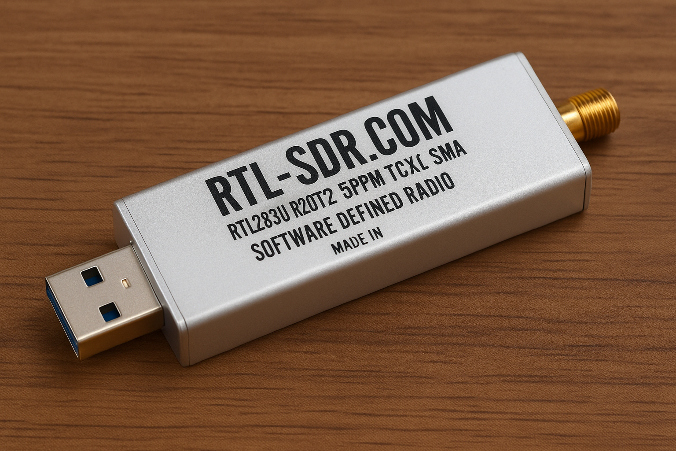
Meet the Ubiquitous RTL-SDR

Slide 8
The RTL-SDR can be used as a wide band radio scanner. Applications include::
Listening to VHF & HF amateur radio.
Decoding ham radio APRS packets.
Listening to amateur radio hams on SSB with LSB/USB modulation.
Listening to satellites and the ISS.
Decoding unencrypted digital voice transmissions such as P25/DMR/D-STAR.
Use rtl-sdr as a panadapter for your traditional hardware radio.
Using rtl-sdr as a spectrum analyzer.
And Many, Many More Applications

Slide 9
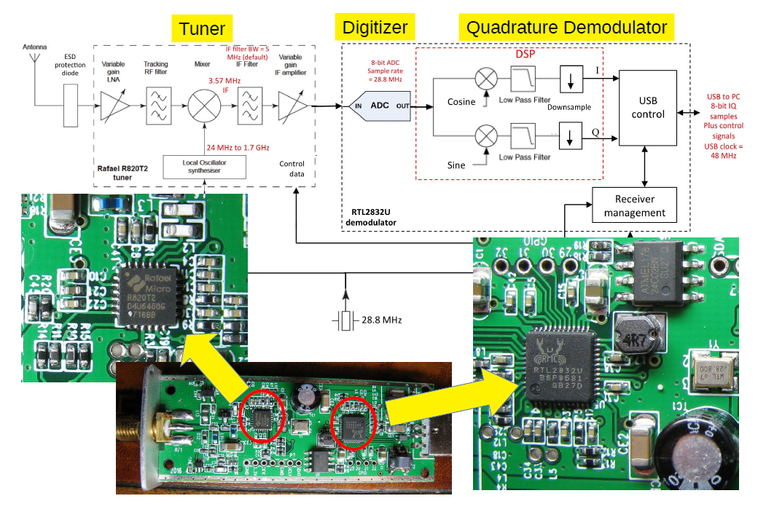
What’s Inside an RTL-SDR?

Slide 10
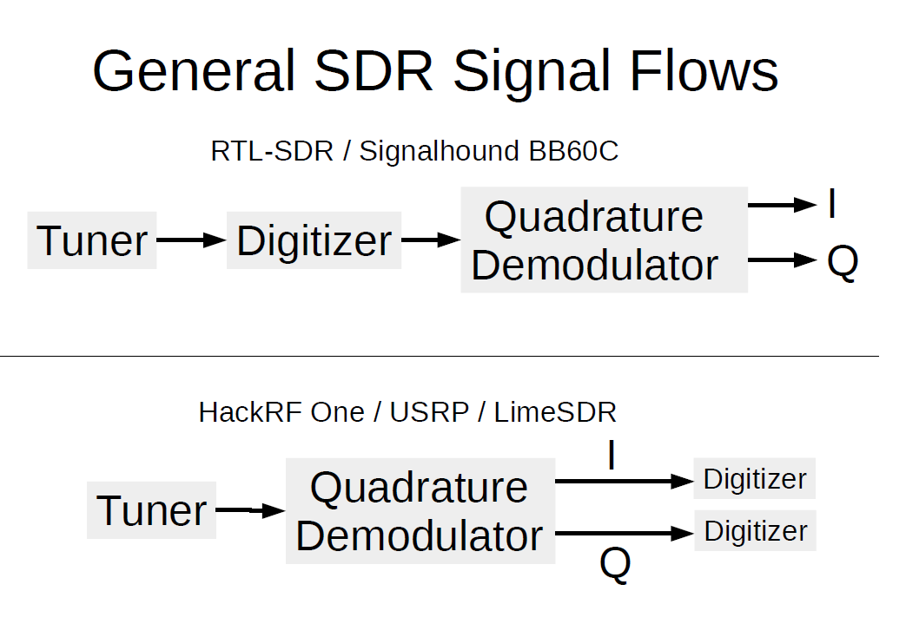
General SDR Flows

Slide 11
What’s IQ and What’s a Quadrature Demodulator?
Hold those questions. We will revisit
IQ after we introduce GNU Radio.

Slide 12

Introducing GNU Radio

Slide 13
What is GNU Radio?
GNU Radio is an open-source software development toolkit used to build and simulate software-defined radios (SDR). It provides signal processing blocks that can be connected together to process real-world signals — such as radio, television, satellite, or cellular communications — entirely in software.

Slide 14
Key Features of GNU Radio
Signal Processing Blocks: Comes with a
library of ready-to-use filters,
modulators/demodulators, FFTs, and more.
Flowgraph Model: Users build “flowgraphs,”
which are diagrams of how
signals are processed from input to output.
Hardware Integration: Works with many SDR
hardware platforms (e.g., USRP, RTL-SDR,
HackRF) but can also run in simulation
without hardware.
Cross-Platform: Runs on Linux, macOS,
and Windows.

Slide 15
Let’s learn by doing. We are going to build a simple FM receiver
Switch to GNU Radio

Slide 16
The Lost in Space Robot says: “Danger Danger!”
The next few slides might cause
your head to explode! LOL

Slide 17
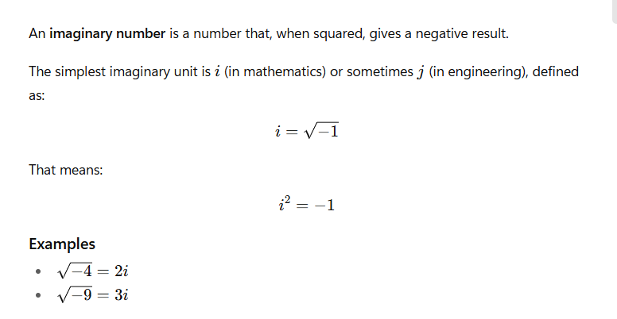
What’s an Imaginary Number?

Slide 18
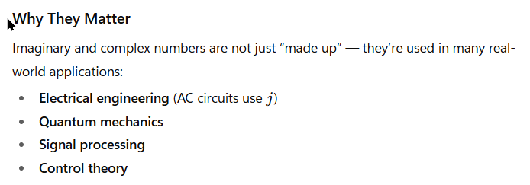
Why They Matter

Slide 19
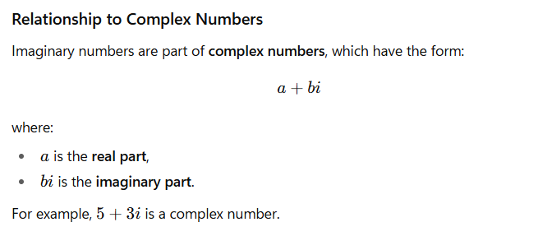
Relationship to Complex Numbers

Slide 20
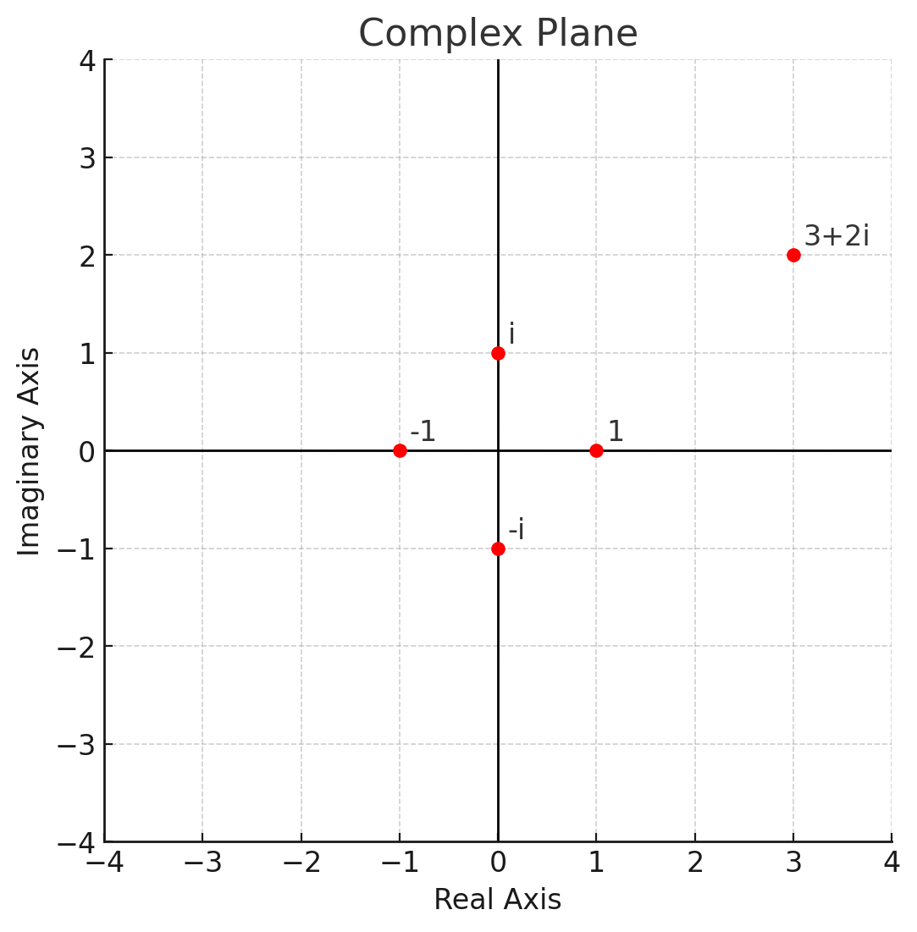
Complex Plane

Slide 21
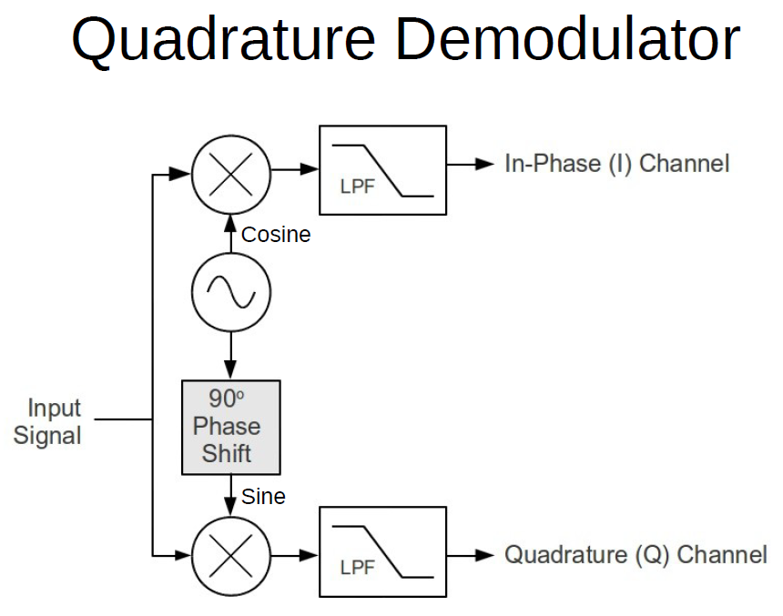
Quadrature Demodulator

Slide 22
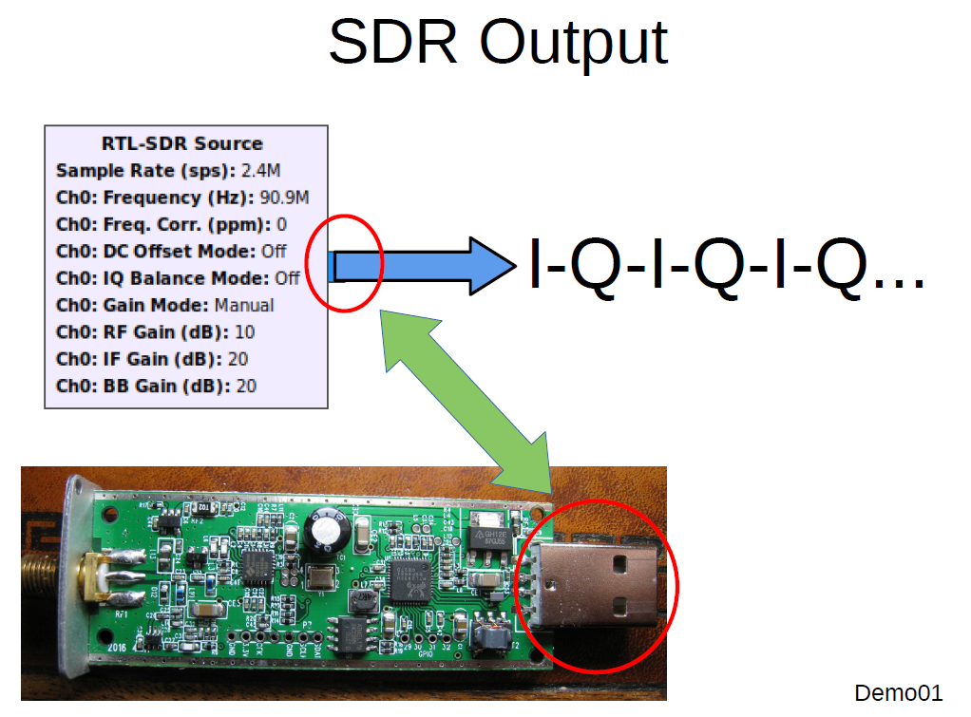
SDR Output

Slide 23
Sampling
Let's talk about sampling next

Slide 24
Nyquist Theorem
To accurately reconstruct a continuous signal from its samples, the sampling rate must be at least twice the highest frequency present in the signal.

Slide 25
Nyquist Theorem Example
Human hearing ranges up to about 20 kHz. To record audio without losing information, the sampling rate must be at least 40 kHz. That’s why CD audio uses 44.1 kHz.

Slide 26
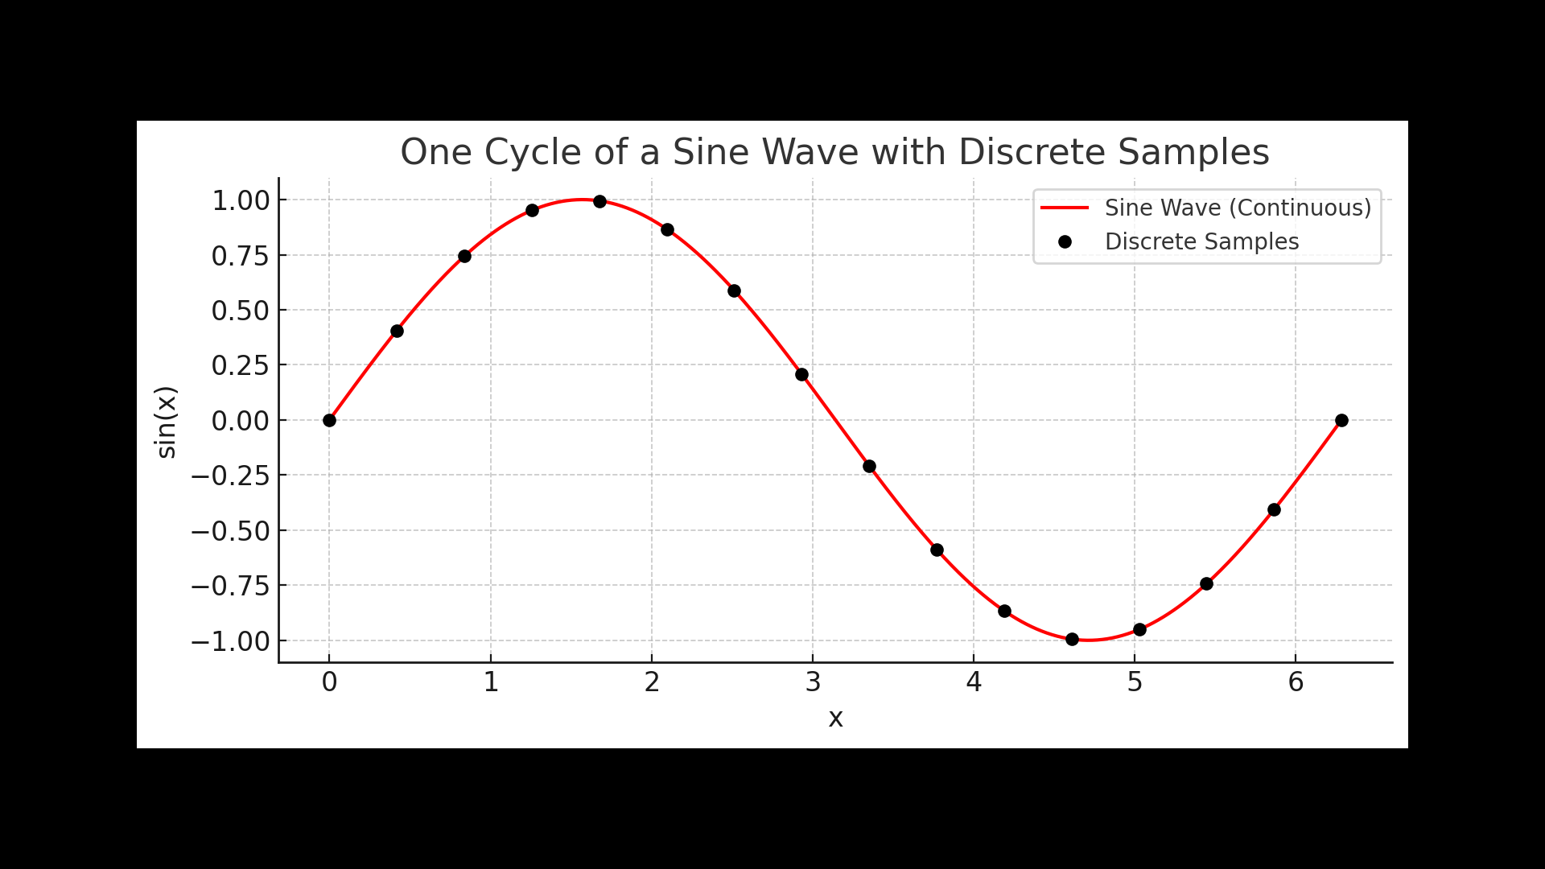
Discrete Samples

Slide 27
What is Aliasing?
Aliasing is a phenomenon that occurs when a continuous signal is sampled at a rate that is too low to capture its changes accurately. As a result, different signals become indistinguishable (or appear as “aliases” of each other) after sampling.

Slide 28
Aliasing in Simple Terms
Imagine you take snapshots of a moving object too slowly → it looks like it’s moving differently than it actually is.
Similarly, if you sample a signal too slowly, high-frequency components “fold back” and look like lower-frequency components.

Slide 29
Aliasing Example
If a 9 Hz signal is sampled at 10 Hz:
Nyquist frequency = 5 Hz
The 9 Hz component will alias and appear as 1 Hz (|9 – 10|).
So, instead of recording 9 Hz, we “see” a fake 1 Hz signal.

Slide 30
How to Prevent Aliasing
Sample fast enough:
Ensure fs≥2fmax
Use an anti-aliasing filter:
A low-pass filter before sampling
removes frequencies above fs/2,
so no high frequencies fold back.

Slide 31
Aliasing Analogy
Think of a spinning wheel in a movie. If the frame rate (sampling) is too low, the wheel may look like it’s spinning slower, backwards, or standing still — that’s aliasing.

Slide 32
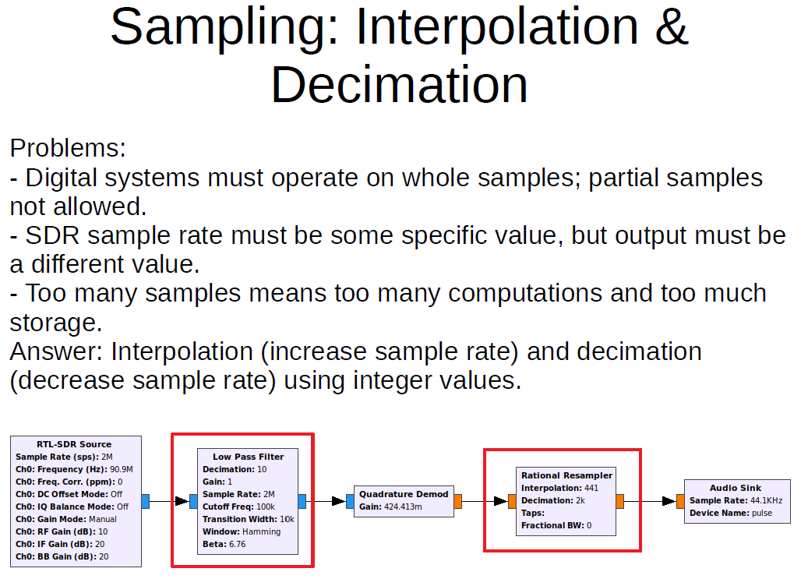
Sampling: Interpolation and Decimation

Slide 33
Interpolation and Upsampling
Interpolation in the process of increasing the number of samples between two known data points. Interpolation in DSP increases the number of samples between discrete-time samples through the process of upsampling and low pass filtering. Interpolation increases the sampling rate for a signal such that a signal will appear to be sampled at a higher frequency.

Slide 34
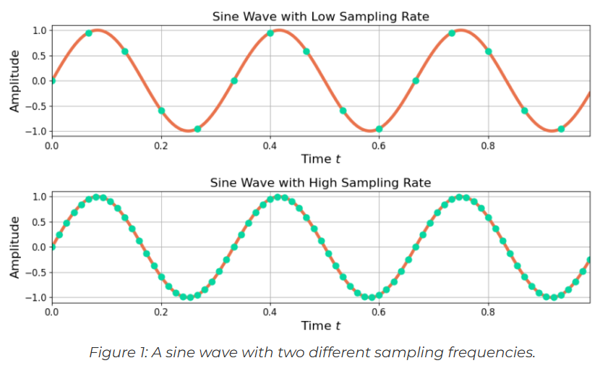
Interpolation and Upsampling Continued
Figure 1 shows the same sine wave with two sampling rates. Interpolation by 5 increases the number of samples, from 15 samples in low sampling rate sine wave to 125 samples in the high sampling rate sine wave. Interpolation is a two step process: upsampling followed by low pass filtering.

Slide 35
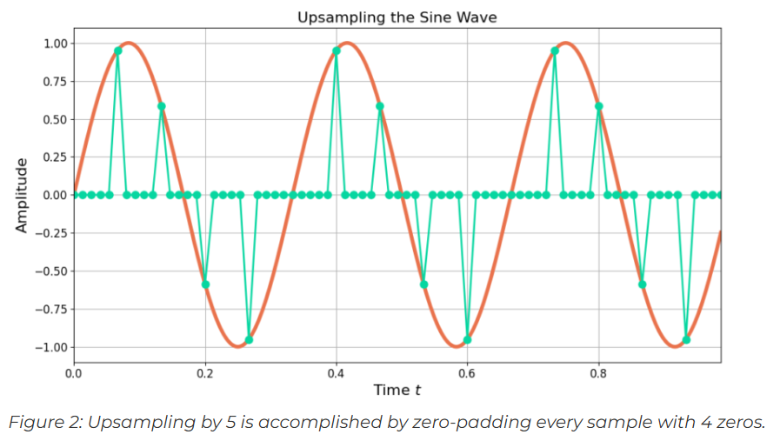
Interpolation and Upsampling
Upsampling is the process of zero-padding a time-series. Upsampling by M increases the number of samples by M through inserting M-1 zero samples after each input sample. Figure 2 shows the low sample rate sine wave being upsampled by 5. Each sample is followed by 4 zeros.
Increasing the number of output samples for every 1 input sample increases the sample rate. Increasing the number of samples by 5 equivalently increases the sampling rate by a factor of 5.

Slide 36
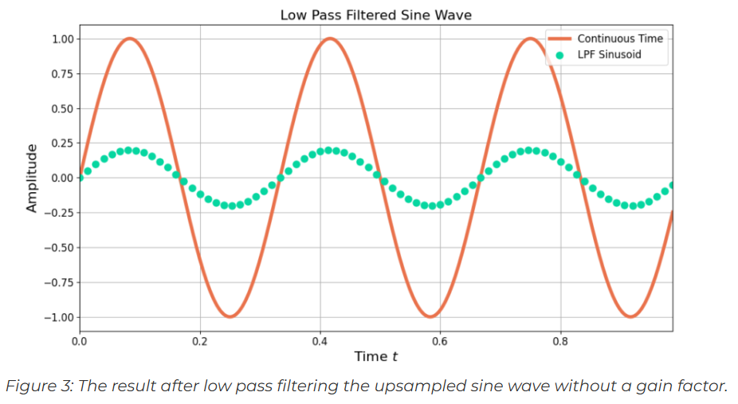
Interpolation and Upsampling
Low pass filtering is needed to smooth the zero-padded signal to fill in the gaps between the non-zero samples. See Figure 3.

Slide 37
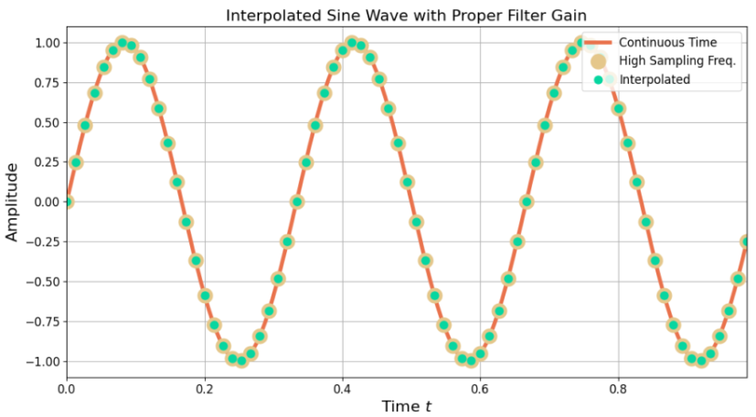
Interpolation and Upsampling
Figure 4: The sine wave after interpolation matches the sine wave which was natively sampled at a higher rate.

Slide 38
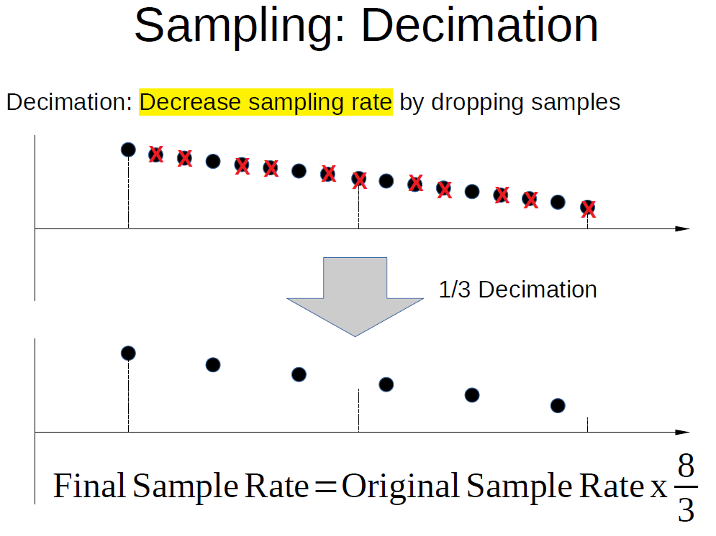
Sampling: Decimation

Slide 39
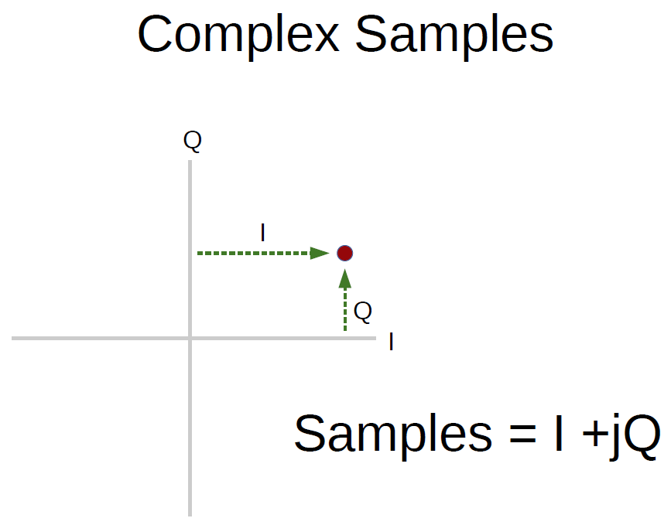
Complex Samples

Slide 40
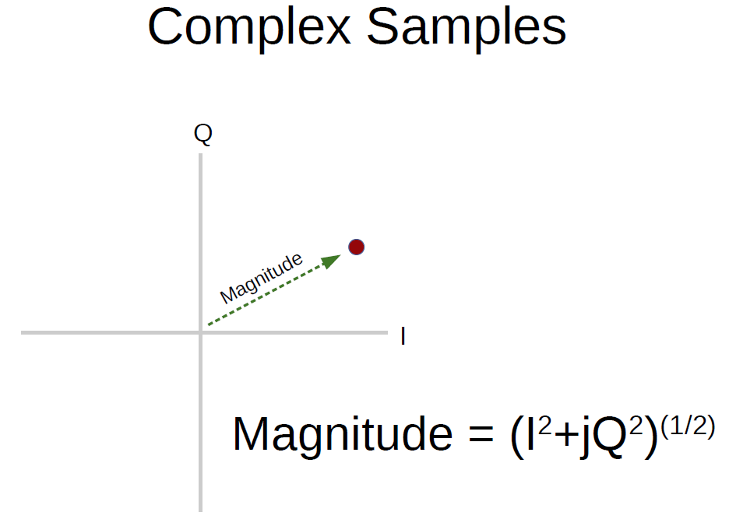
Magnitude of a Complex Number

Slide 41
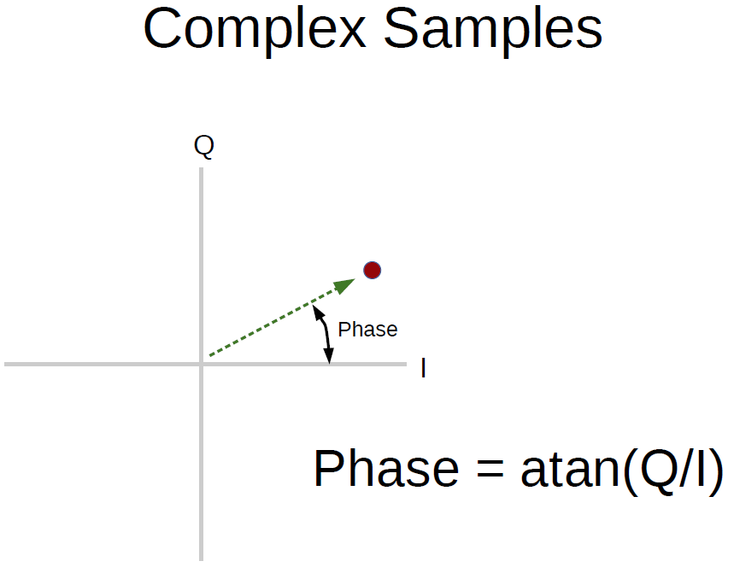
Phase of a Complex Number

Slide 42
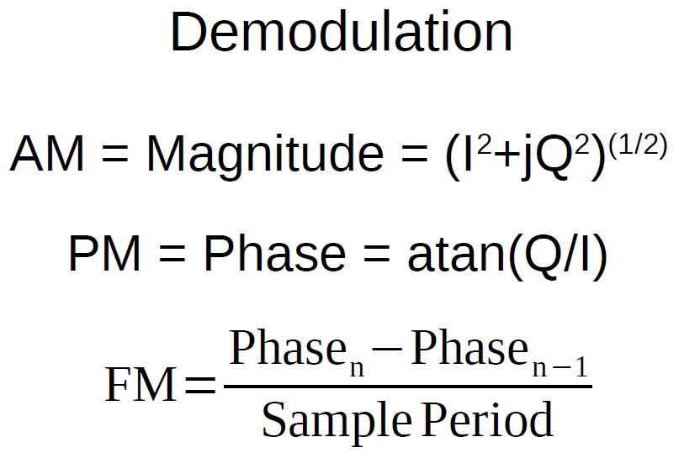
Demodulation Using Complex Numbers

Slide 43
Fun Fact
The ICOM 7300 sampling rate is 124.032 MHz and it digitizes the entire HF spectrum after filtering out some unwanted frequencies to prevent overload (clipping) of the ADC. It is then down-converted in the digital domain (in an FPGA) and demodulated. There is aliasing at some VHF frequencies (outside the ham bands).

Slide 44
Narrowband FM and Single Sideband Receivers
Switch to GNU Radio and Look at Narrowband FM and Single Sideband Receivers

Slide 45
Resources
See my YouTube Channel: paulmaine6433
You can download the files from:
GitHub Repository: https://github.com/pmaine/The-SDR-Guy

Slide 46

Questions?

Slide 47

Let’s See Who Wins the Door Prize!

Slide 48

Thanks for Letting Us Share about SDR’s!

